Slide 2
Balancing Act
Prioritizing workloads with multiple demands and deadlines
Aaron Crandall, Social Science Research Services, L&S

Slide 3
Tips to Prioritizing Work
Assess tasks: Consider each task's importance, urgency, effort, and resources required.
Set deadlines: Assign deadlines to tasks, even if they don't have an official one.
Break down large tasks: Split big tasks into smaller, more manageable parts.
Delegate: Identify tasks that can be completed by others.
Eliminate or postpone: Remove tasks that aren't essential to your current goals or priorities.
Batch similar tasks: Group similar tasks together and tackle them in one go.

Slide 4
Tips Cont’d
Use a prioritization framework: Use a framework like the Eisenhower Matrix or the ABCDE Method to categorize your tasks.
Define priorities for the day: Before the end of the day, select the most important tasks you need to do the next day.
Put away distractions: Avoid distractions like your phone, email, and social media.
Flag priorities in your calendar: Use a color-coding system to quickly see how you're doing.
Reassess priorities regularly: Priorities will change, so adapt and reassess them regularly.

Slide 5
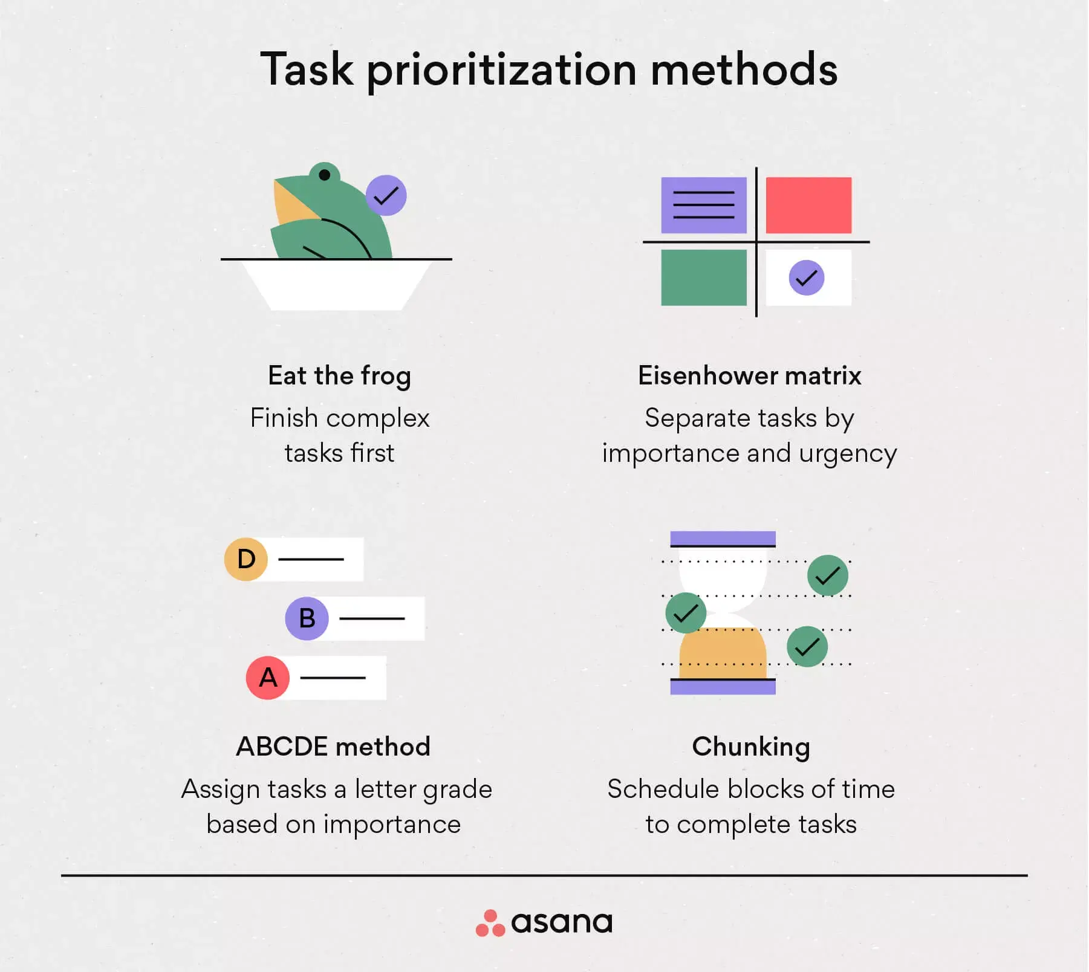
Prioritization Methods
Notes:
Eat the frog: Important tasks that serve the highest purpose and are tied to top-level objectives or OKRs should be first on the priority list when you start your day. Once you’ve eaten your frog for the day, you can slot in other tasks based on factors such as deadlines and feel less stress, since your most important work is already done.
ABCDE: Rank tasks from A to E with A being most important, using columns
Chunking: For the chunking method, a chunk is defined as a focused work activity. It can be self-contained (emptying your inbox), a slice of a larger project (completing the first draft of a document), or a collection of small, unrelated tasks. Your key here is to make these chunks focused, uninterrupted blocks of time.

Slide 6
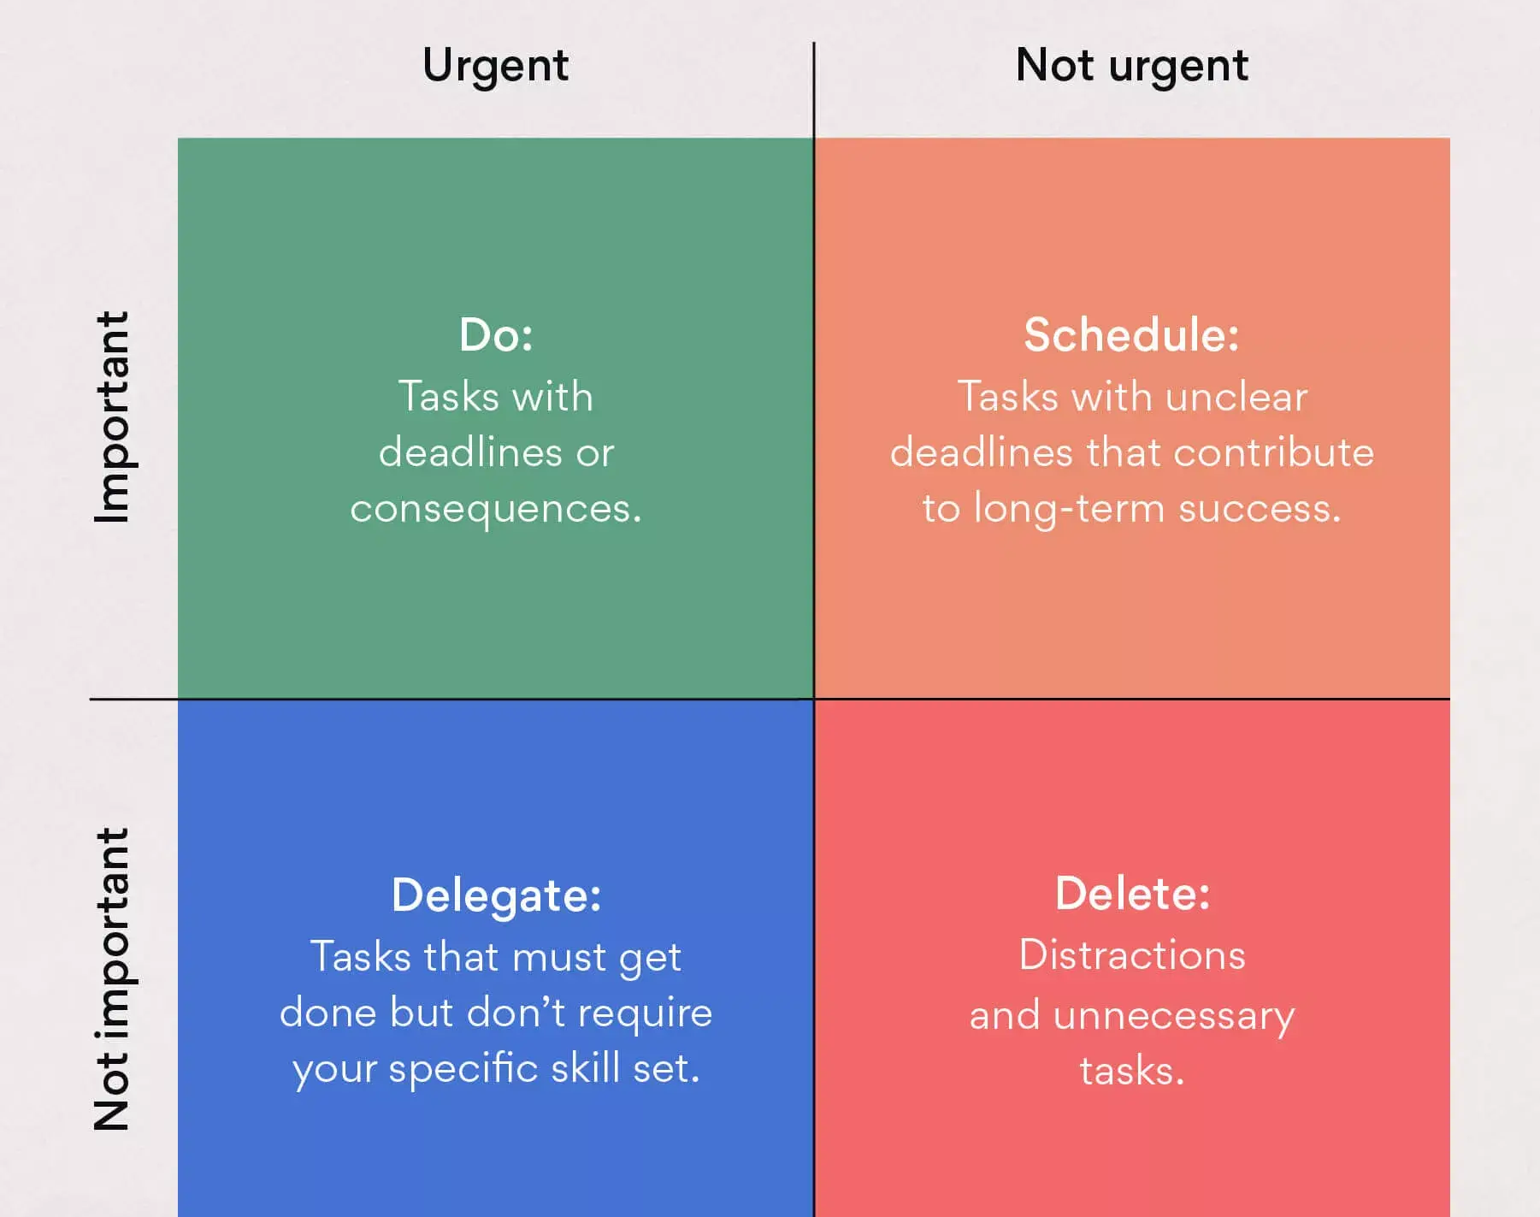
Eisenhower Matrix
The Eisenhower Matrix is a task management tool that helps you organize and prioritize tasks by urgency and importance. Using the tool, you’ll divide your tasks into four boxes based on the tasks you’ll do first, the tasks you’ll schedule for later, the tasks you’ll delegate, and the tasks you’ll delete. In this piece, we’ll explain how to set up an Eisenhower Matrix and provide tips for task prioritization.
Notes:
Priority matrix

Slide 7
Most Important Task Method
The Most Important Task (MIT) method is an effective and simple strategy for prioritizing daily tasks that have a significant impact on the whole business. Each day, MIT selects between one and three key tasks that need to be completed by the end of the day. These tasks are not just any to-do list items but are specifically chosen for their significance in advancing towards your long-term goals.

Slide 8
To-Do List Methods
Calendar
Running List
Limits indecision
Good for scheduling work-life balance
Keeps you on-task
Scary to look at, messy
Tasks may get rearranged with schedule changes
No checking off completed tasks
Limits indecision
Results in high focus
High task-completion rate
DOUBLE DOPAMINE
Difficult to fit in tasks around meetings
Notes:
Running is good for daydreamers, multitaskers, or people who are easily distracted.

Slide 9
To-Do Cont’d
Digital Task Manager
Make Three Lists
Great for organizing lots of tasks (including short and longer-term ones)
Scheduling recurring tasks frees up brain space
Saves trees
Hard to track in-progress tasks
Keeps you organized
Narrows down your list
Relieves anxiety about future projects
All the scheduling can get overwhelming
Not motivational
Easy to lose physical lists
Notes:
Digital ex.: Todoist
3 lists: list for non-time-sensitive; list for things for today; & another list for your forever to-do list; good for people who have competing priorities, who love crossing easy items off their list

Slide 10
Software Tools
Trello
Todoist
Asana
ClickUp
Microsoft To Do
Notion
Evernote
Monday.com
Wrike
Google Keep
2Do
Zoho
For the simplest, stick with Todoist, Microsoft To Do, or Google Keep

Slide 11
Recap
Prioritizing tasks is crucial for the following reasons:
Improved time management
Increased Productivity
Avoiding being overwhelmed
Better decision-making
Meeting deadlines
Maximizing impact
Aligning with long-term goals
Resource Management

Slide 12
Questions & Final Thoughts
Thank you for participating in today’s discussion!
Aaron Crandall
Director, Social Science Research Services
aaron.crandall@wisc.edu

